Slide 1
e-business
Computers in Manufacturing Enterprises
September 28, 2015
Vandana Srivastava

Slide 2
e-business: Introduction
application of information and communication technologies (ICT) in all the activities of business
the term "e-business" was coined by IBM's marketing and Internet teams in 1996
business activities are enabled by:
application of internet technologies (intranet, extranets(controlled access from outside of an organization's intranet))
and related standards (HTTP, HTML, XML etc)
looks at all possibilities where electronic communication can be used to enhance all aspects of a company’s SCM and optimize its value-chain
http://www.ifp.uni-stuttgart.de/publications/phowo01/Reiss.pdf

Slide 3
e-business: Basics
based on various types of trading partners, there are many categories of e-business:
Business to Business (B2B): automobile manufacturer buying tires, glass for windscreens etc for its vehicles
Business to Consumer (B2C): Flipkart selling books to you
Consumer to Business (C2B): monster.com
Consumer to Consumer (A sells his car to B, eBay), Peer to Peer (P2P, Airbnb), Government to Citizen(G2C: Income Tax portal), Citizen to Government (C2G) and Intra-business (Organization Unit to Organization Unit)
main categories of e-business applications:
Electronic markets or e-marketplaces: in buying and selling of goods and services
Inter-organizational systems: facilitating inter and intra-organization flow of goods, services, information, communication, and collaboration
Customer service: providing customer service, help, handling complaints, tracking orders, etc.
http://staffweb.hkbu.edu.hk/vwschow/Case-study.pdf

Slide 4
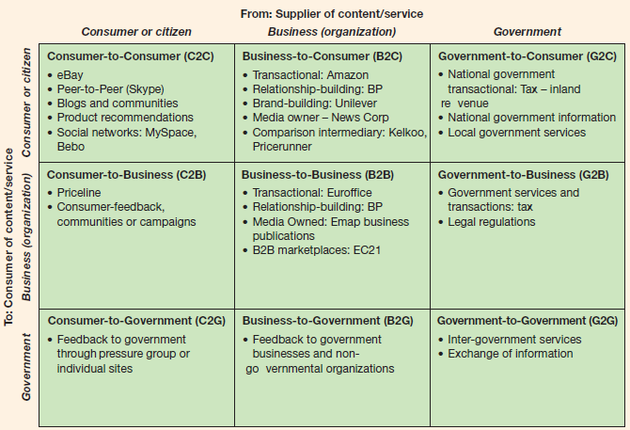
Examples: e-business Categories
https://geomart25.files.wordpress.com/2014/05/dave-chaffey-e-business-and-e-commerce-management-strategies-4th-ed-qwerty80.pdf

Slide 5
e-business: Major Success Factors
completely integrated Internet technology in company’s strategy
basis of competition not shifted from traditional competitive advantage, such as cost, profit, quality, service, and features
analyzing buyer behaviour and customer personalization to respond quickly to market needs
e-business education and training to employees and management
Customer’s and partners’ expectations well-managed
tracking new competitors and market shares
high quality, simple to use websites that meets or exceed user expectations

Slide 6
Key Expenditures Involved in e-business
http://www.gov.pe.ca/photos/original/IPEI_ebiz_book.pdf

Slide 7
e-business: Opportunities
AFFILIATION
refers to potential customers who can be reached
internet enables to reach globally at low cost
also refers to the number of products and categories covered
RICHNESS OF INFORMATION
REACH
detailed information about products, prices and availability
customization based on preferences
better and successful partnership with suppliers
Google books: E-Business and E-Commerce Management By Chaffey Dave

Slide 8
e-business: Tangible and Intangible Benefits

Slide 9
e-business VS e-commerce
e-business
e-commerce
includes e-commerce, Internet marketing, e procurement etc.
applications strive to give a good idea of their company, promoting the values they use to market their business
transactions involving money are "e-Commerce" activities including the interactions with business partners, customers, vendors
refers to online transactions - buying and selling of goods and services over the Internet
involving transaction of monetary nature
subset of E Business.
focuses on appearance much more than e-business

Slide 10
Case study in e-business

Slide 11
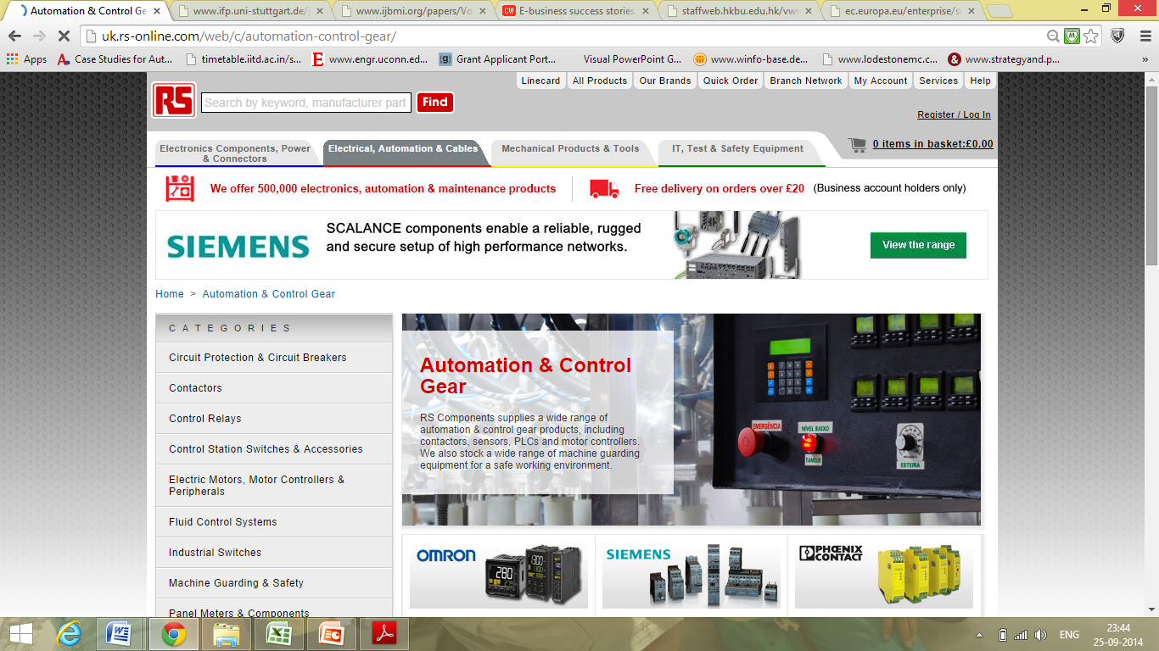
RS-Components (B2B)
Company
one of Europe's leading distributors of electronic and mechanical parts
operates in 22 countries and stocks 500,000 different products from 1,200 suppliers
Problem Background
in UK, the company's main sales channel to its 400,000 customers was its 550-page, 5kg catalogue which cost the company £30 per copy to produce
company often send customers, product information sheets, costing between 50p - £5 depending on their location
call centre ordering process was very paperwork intensive, costing average customer £60 per order -> very expensive, as the average order was worth £100
Initiative
company started sending customers CD-Rom versions of its catalogue in 1994
http://www.computerweekly.com/feature/E-business-success-stories-They-do-exist

Slide 12
e-business solution: RS Components
started developing its Internet Trading Channel (ITC) in the UK, with the help of e-business software company, Broadvision
site lists products and their specifications, reducing the cost of publishing, updating and distributing catalogues and data sheets
site eliminated the paperwork involved in ordering parts-> reducing the purchasing costs to suppliers
started using personalization technology to know its customers, by storing their purchasing history, preferences and buying habits
moved the UK systems over to a European Internet trading platform and the company will roll out multi-language, multi-currency sites in 10 other European countries
working with e-business platform suppliers such as Oracle, SAP, Ariba and CommerceOne to enable its customers to link their own e-procurement systems in with the RS Components online sales system, and has more than 30 international customers using this service
http://www.computerweekly.com/feature/E-business-success-stories-They-do-exist

Slide 13
e-business solution: RS Components
Project launched 1998
Cost of Internet Trading Channel project so far is around £5m
UK Internet revenues of £30m over the last year (8% of total sales)
The site has 250,000 registered users, 97% of them new contacts
Site achieves 1200 orders per day
The £60 average cost of placing an order has been cut by 80%.
Cambridge Consultants, for example, places 7,000 orders, worth £7.5m, per year. It has cut its average order costs from £90 to £10, saving £100,000 per year
http://www.computerweekly.com/feature/E-business-success-stories-They-do-exist

Slide 14
Video Case Study
eBusiness Advance Case Study - Musselburgh Race Track
(http://www.youtube.com/watch?v=miSwGS1URB4)

Slide 15
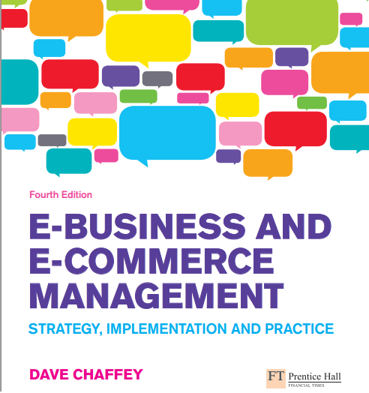
For Further Reading.....
https://geomart25.files.wordpress.com/2014/05/dave-chaffey-e-business-and-e-commerce-management-strategies-4th-ed-qwerty80.pdf

Slide 16
e-business in India: Growing Sectors
Real estate buying, selling, renting
Online trading / banking
Travel and Tourism
Employment sites
Government Related
gifting sites

Slide 17
Syllabus for Minor 2
Date:8th October, 2015
Syllabus (lecture slides, case-studies, class discussions and handouts)
extended enterprises
Supply Chain Management
e-business and ERP

Slide 18
Discussion!
e-business scenario in India
need?
current situation?
which sectors need to work more on transforming their business?
how are SME’s reaction to e-business?
suggestions?

